Slide 1

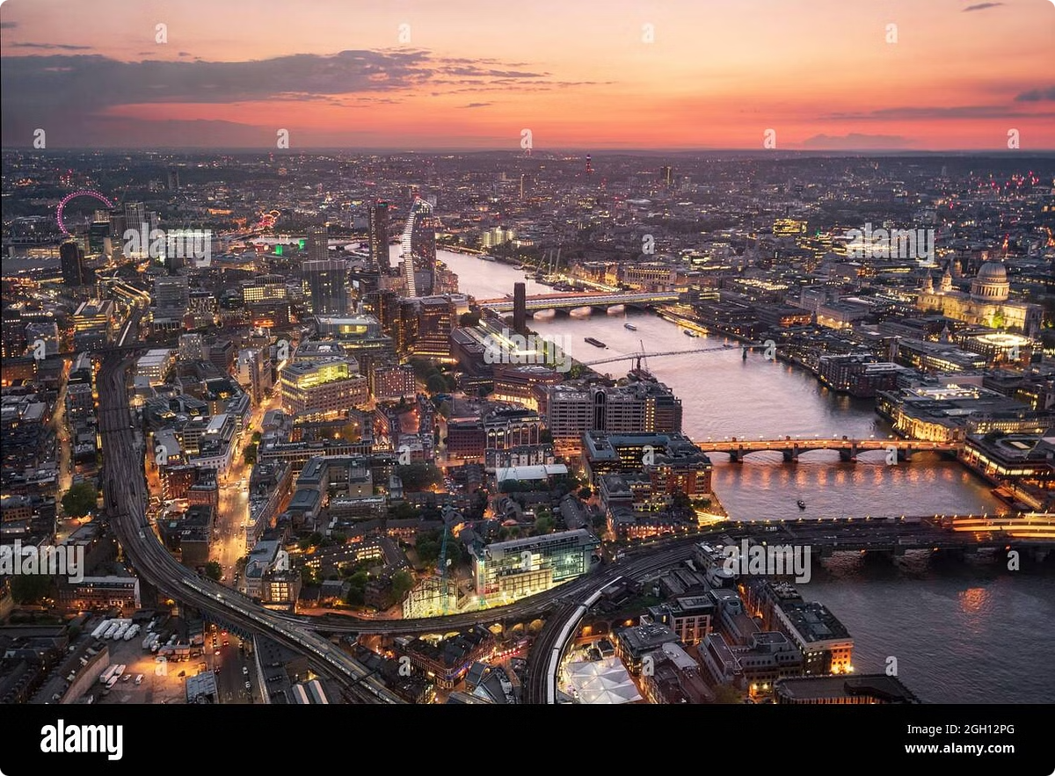
Welcome to London, the Vibrant Capital of the UK
Explore the rich history, iconic landmarks, and diverse neighborhoods of this bustling global city.
P
by Philipp

Slide 2
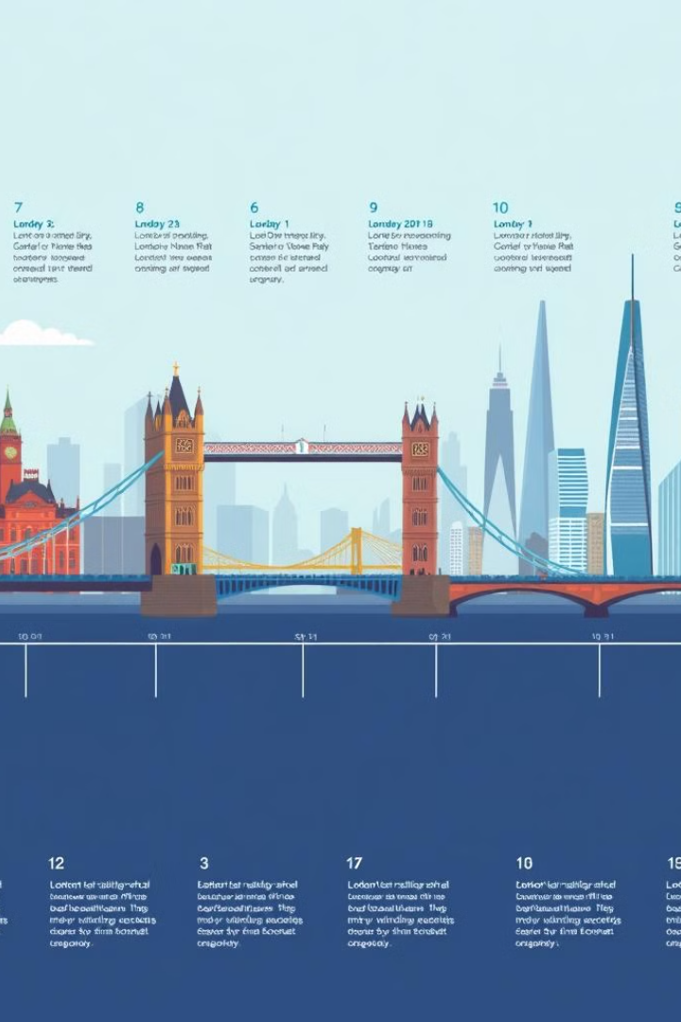
Exploring the City's Rich History
1
Ancient Origins
Tracing back to Roman times and beyond.
2
Medieval Landmarks
From the Tower of London to Westminster Abbey.
3
Modern Transformation
Blending historic and contemporary architecture.

Slide 3
Iconic Landmarks and Architecture
Big Ben and Parliament
Tower Bridge and the Thames
Buckingham Palace
Instantly recognizable symbol of British government.
Beautiful suspension bridge over the river.
Majestic residence of the British royal family.

Slide 4
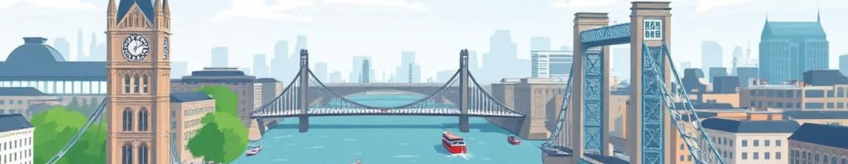



The River Thames and its Bridges
Boat Tours
Walking Bridges
Historic Crossings
See the city from the river's perspective.
Pedestrian-friendly ways to cross the Thames.
From ancient fords to modern engineering marvels.

Slide 5
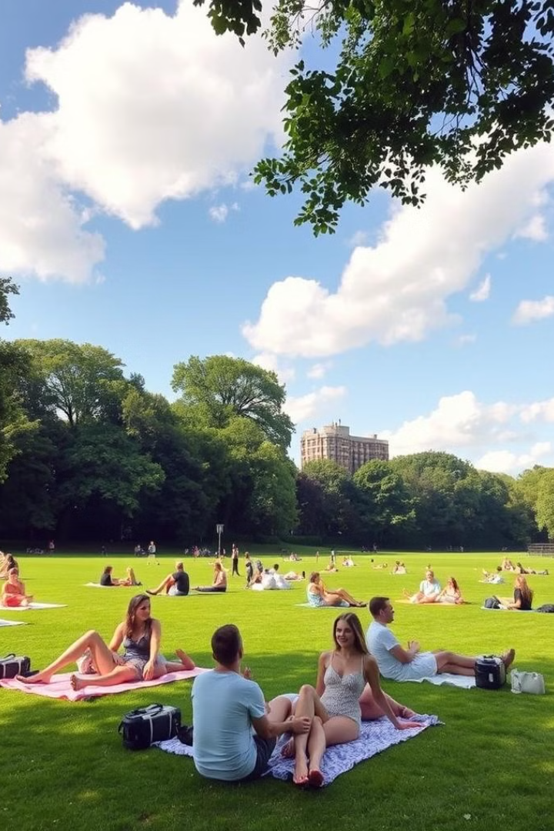
Parks and Green Spaces in London
Hyde Park
Regent's Park
Vast urban oasis for recreation and relaxation.
Home to the London Zoo and rose gardens.
Hampstead Heath
Kew Gardens
Hilly expanse with ponds and scenic views.
Stunning botanical gardens showcasing plant diversity.

Slide 6
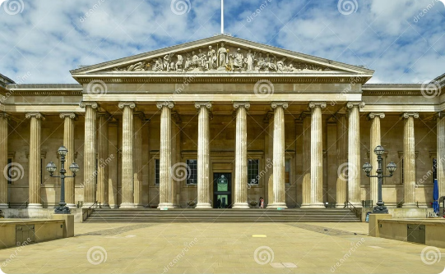
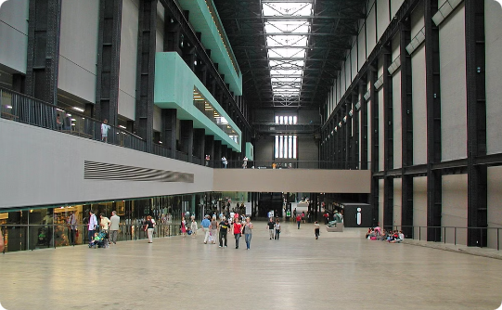
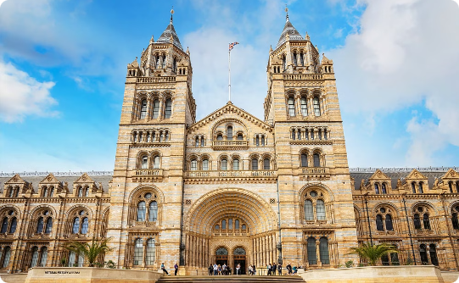
Museums and Cultural Attractions
British Museum
Tate Modern
Natural History Museum
Unparalleled collection of ancient artifacts and art.
Leading modern and contemporary art gallery.
Fascinating exploration of the natural world.

Slide 7
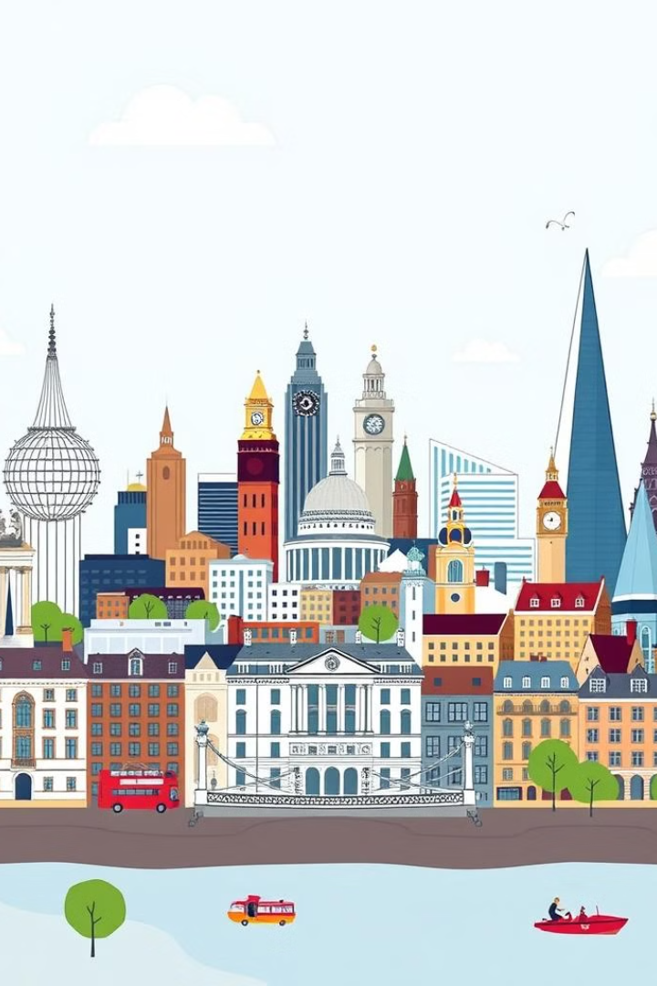



London's Diverse Neighborhoods
City of London
Financial district with towering skyscrapers.
West End
Vibrant hub of theater, music, and entertainment.
Notting Hill
Charming streets and iconic pastel-colored homes.

Slide 8
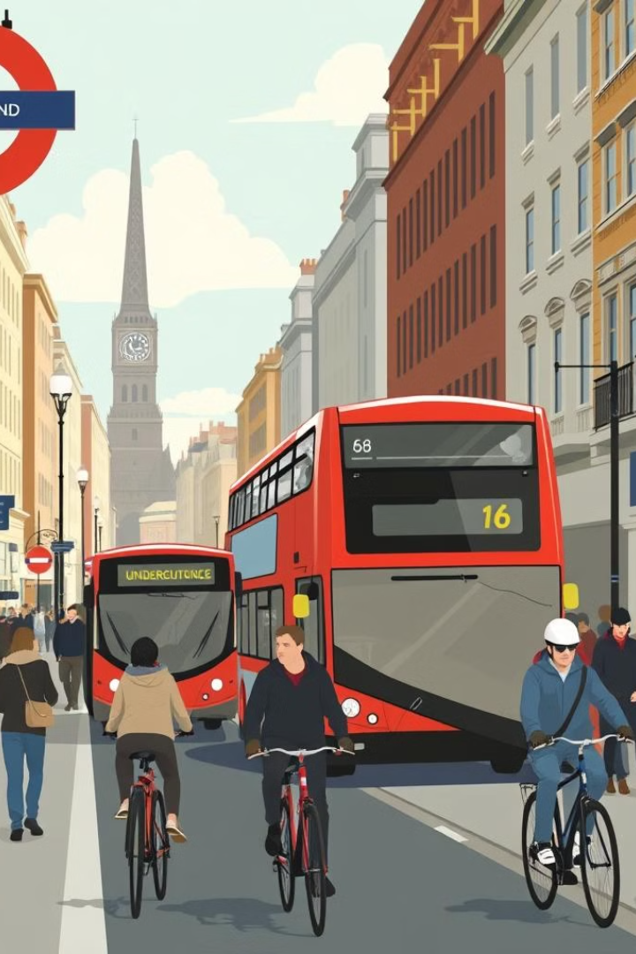
Transportation in the City
1
Underground Tube
2
Double-Decker Buses
Extensive subway system for easy city travel.
Iconic red buses connect neighborhoods.
3
Bike Sharing
Eco-friendly way to explore the city.

Slide 9


Fun Activities for Kids in London
Natural History Museum
Discover dinosaurs and marvel at nature.
Science Museum
Interactive exhibits and hands-on learning.
London Eye
Panoramic views of the city from the wheel.
Warner Bros. Studio Tour
Behind-the-scenes of the Harry Potter films.

Slide 10

Why London is an Amazing Place to Visit
1
Diverse Culture
2
Iconic Landmarks
3
Endless Experiences
Vibrant mix of people, cuisines, and traditions.
Timeless architecture and historic sites to explore.
From world-class museums to lively markets.

