Slide 1

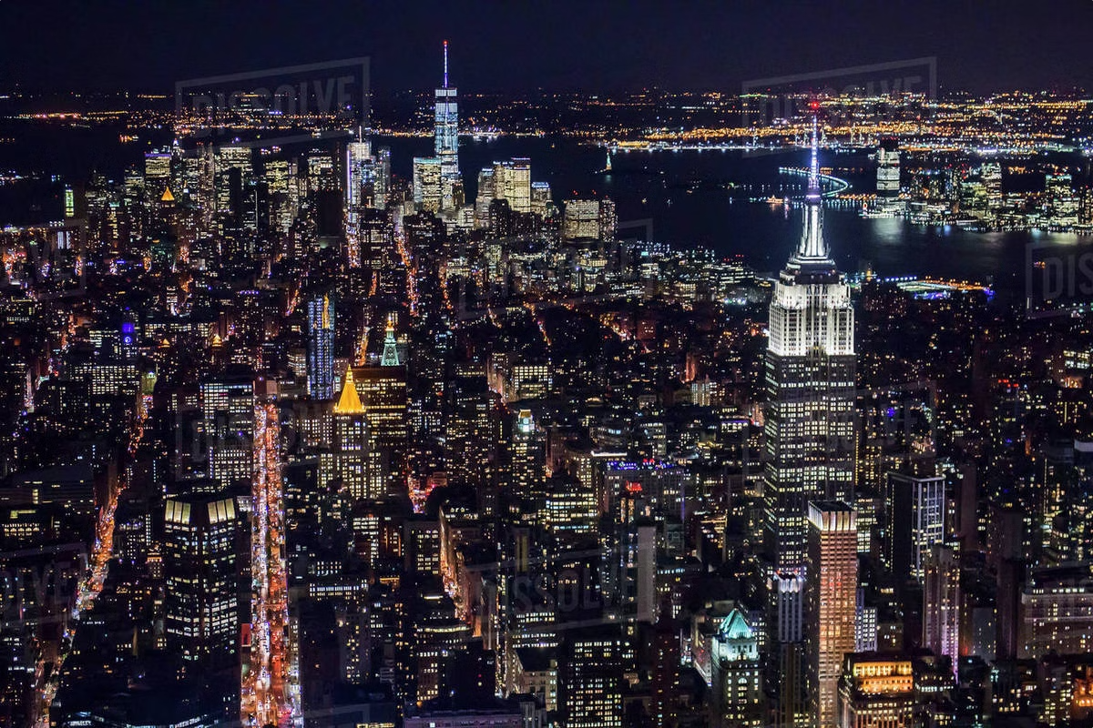
New York City: A World-Class Metropolis
Towering skyscrapers, pulsing with energy, New York City stands as a global center of finance, culture, and innovation. From its iconic landmarks to its diverse neighborhoods, the Big Apple captivates visitors with its sheer grandeur and boundless opportunities.
P
by digbi

Slide 2
From Skyscrapers to Subways: The Iconic Landmarks of NYC
Skyscrapers
Landmarks
Subway System
The city's towering skyscrapers, like the Empire State Building and One World Trade Center, define the iconic skyline and showcase New York's architectural prowess.
Iconic landmarks like the Statue of Liberty and Brooklyn Bridge embody the city's rich history and spirit of innovation.
The expansive subway system, one of the largest and busiest in the world, connects the city's diverse neighborhoods and enables the flow of millions of people daily.

Slide 3
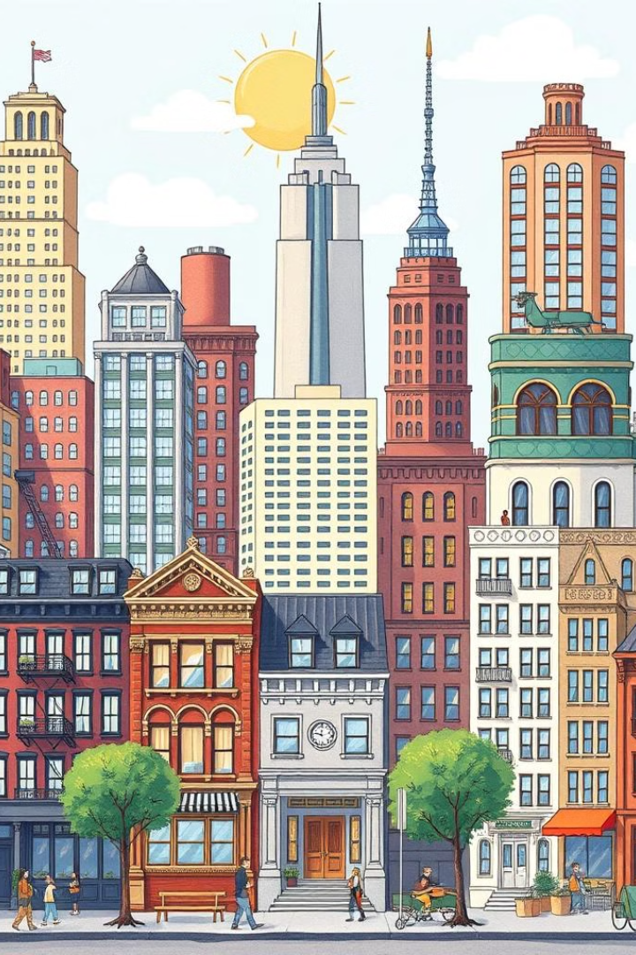
The Big Apple's Diverse Neighborhoods
SoHo
Chinatown
Known for its trendy boutiques, art galleries, and loft-style apartments, SoHo is a hub of creativity and high-end shopping.
Bustling with authentic Chinese restaurants, markets, and traditional medicine shops, Chinatown offers a glimpse into the city's diverse cultural heritage.
Greenwich Village
Harlem
This iconic neighborhood is renowned for its charming, tree-lined streets, lively music scene, and vibrant street life.
Harlem is a historically African American neighborhood that has become a hub of cultural expression, with world-famous jazz clubs and soul food restaurants.

Slide 4

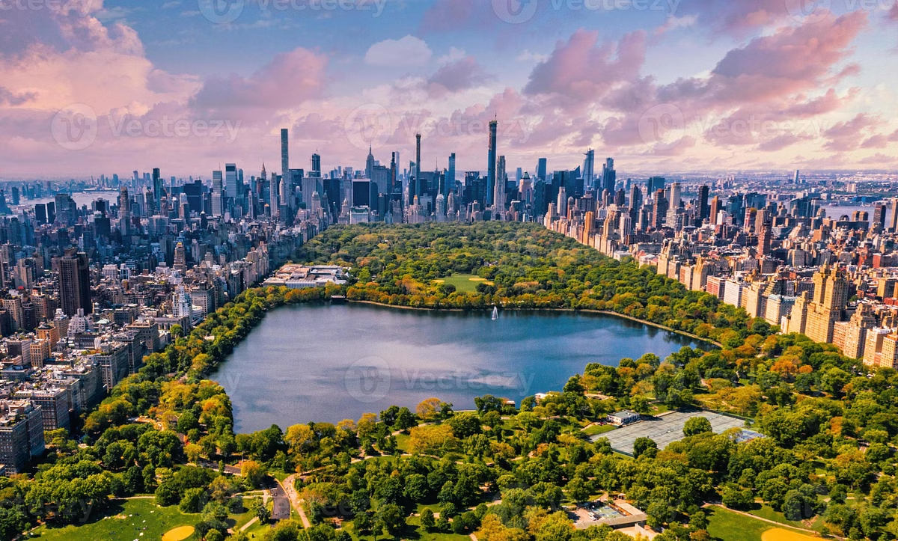
Exploring Central Park: A Vast Urban Oasis
1
Nature Escape
Spanning over 840 acres, Central Park offers a lush, natural respite from the bustling city, with expansive lawns, lakes, and forests.
2
Recreation
The park features a wide range of recreational activities, from boating and biking to ice skating and jogging, catering to visitors of all ages and interests.
3
Cultural Attractions
Iconic landmarks like the Bethesda Fountain, the Metropolitan Museum of Art, and the Belvedere Castle make Central Park a hub of cultural and artistic experiences.

Slide 5

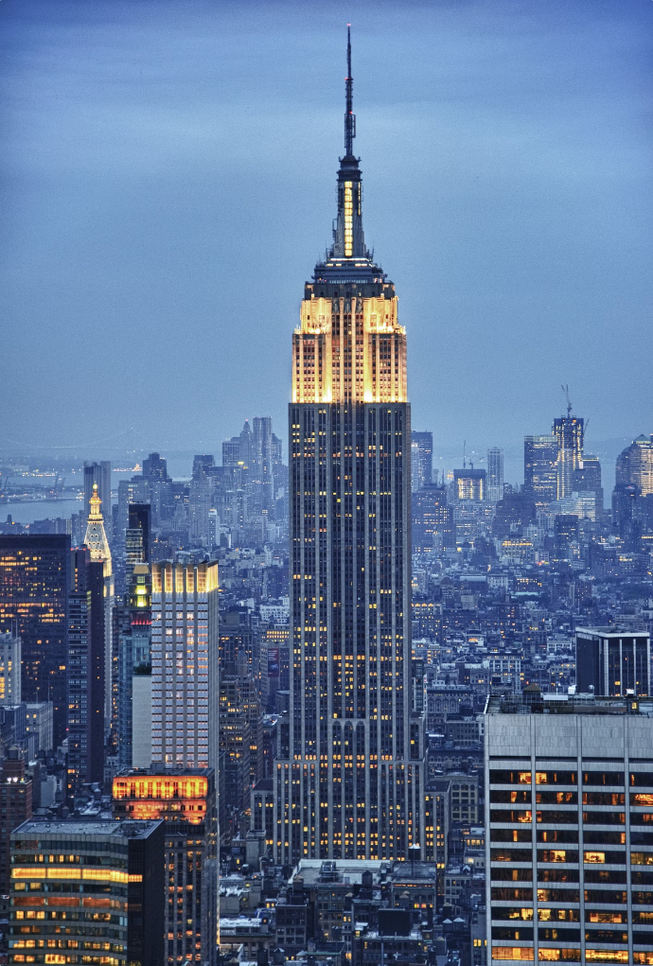



The Empire State Building: Reaching for the Heavens
Iconic Architecture
The Empire State Building's art deco design and soaring height of 1,454 feet make it an architectural masterpiece and one of the most recognizable landmarks in the world.
Observation Decks
Visitors can take in breathtaking 360-degree views of the city from the building's observation decks on the 86th and 102nd floors.
Lighting Displays
The building's exterior is illuminated with colorful lighting displays that change to celebrate special occasions and events.

Slide 6


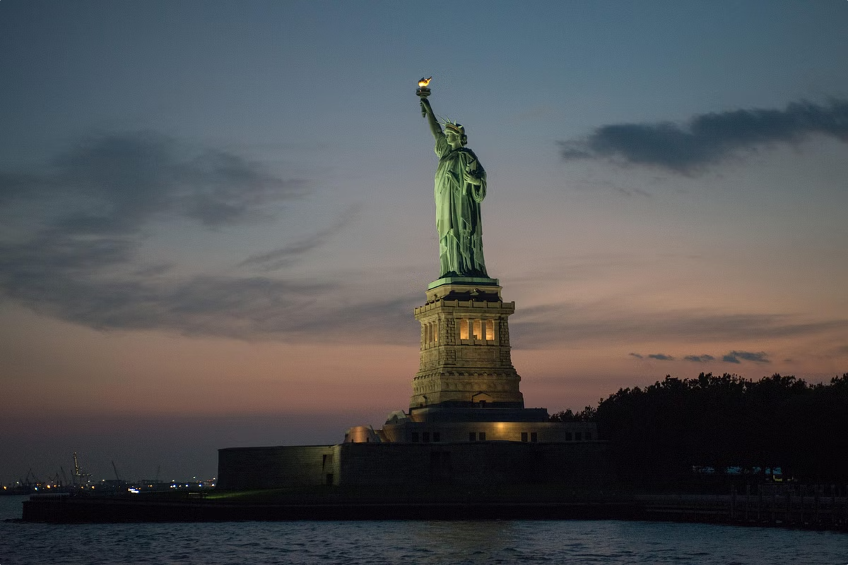


The Statue of Liberty: A Symbol of Freedom
Iconic Landmark
The Statue of Liberty, a gift from France, has stood as a symbol of freedom and democracy for over 130 years.
Ellis Island
Visitors can access the statue and its museum via a short ferry ride from nearby Ellis Island, the historic gateway for millions of immigrants to the United States.
Unique Experience
Climbing to the crown of the statue offers a breathtaking view of the New York Harbor and the city skyline, making it a must-visit destination for any visitor to New York.

Slide 7

Broadway: The Heart of American Theater
1
World-Class Productions
2
Diverse Offerings
3
Vibrant Energy
From classic musicals to cutting-edge dramas, Broadway offers a diverse range of performances to suit all tastes and interests.
The iconic Theater District, with its bright lights and bustling crowds, creates an electric atmosphere that captivates visitors from around the world.
Broadway is renowned for its spectacular theater productions, featuring renowned actors, dramatic storylines, and lavish costumes and sets.

Slide 8

Delicious Diversity: Dining in New York City
Pizza
Renowned for its iconic thin-crust style, New York-style pizza is a quintessential part of the city's culinary landscape.
Bagels
Freshly baked bagels, with a wide range of toppings and fillings, are a beloved breakfast staple in New York City.
Ethnic Cuisine
The city's diverse immigrant population has contributed to a vibrant and eclectic food scene, with authentic cuisines from around the world.
Street Food
From hot dogs and pretzels to food trucks and carts, the city's iconic street food offers a delicious and convenient dining experience.

Slide 9
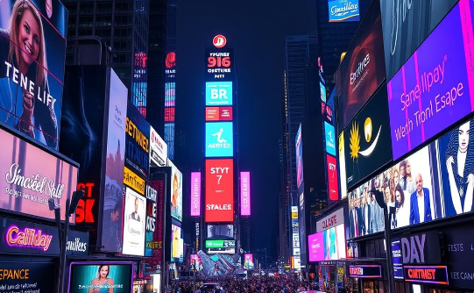
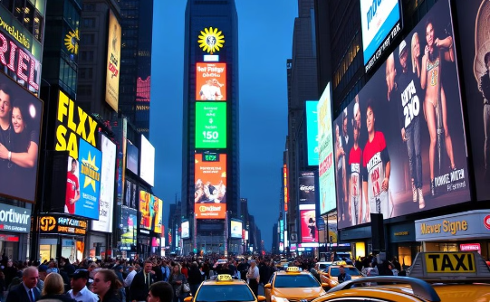
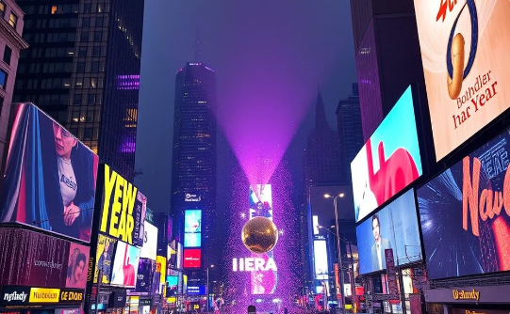
Bright Lights, Big City: The Energy of Times Square
Dazzling Lights
Vibrant Energy
Iconic Events
Times Square is renowned for its dazzling array of neon lights, electronic billboards, and digital screens that create a mesmerizing, larger-than-life atmosphere.
The constant flow of people, performers, and street vendors in Times Square contribute to an electric, high-energy environment that never sleeps.
Times Square hosts numerous iconic events throughout the year, such as the famous New Year's Eve ball drop, drawing massive crowds and global attention.

Slide 10

Conclusion: Why New York is a Must-Visit Destination
New York City is a one-of-a-kind destination that offers an unparalleled blend of history, culture, architecture, and energy. From its towering skyscrapers and iconic landmarks to its diverse neighborhoods and world-class dining, the Big Apple is a must-visit for anyone seeking an unforgettable travel experience.

